Slide 1

CS 533 INTRO TO DATA SCIENCE
Michael Ekstrand

Slide 2
SIMULATION

Slide 3

Learning Outcomes
Simulate data to understand statistical behavior
Understand the difference between simulation and the bootstrap
Photo by Markus Spiske on Unsplash

Slide 4
Simulation
We can make up data (with a random number generator)
We know the population parameters (we set them)
We can take unlimited samples (it’s just an RNG)
Result: we can study the behavior of sampling and statistical methods

Slide 5
Setting Up the RNG
Modern: np.random.Generator
Create with np.random.default_rng()
Can provide a seed (starting point) - integer
Recommended!
Same seed + software versions + platform ⇒ same results
Legacy: np.random functions
Python standard library also has random module

Slide 6
Drawing from Distributions
integers(k, size=n) — n integers in range [0,k)
integers(j, k, size=n) — n integers in range [j,k)
random(n) — n floats uniformly from [0,1)
normals(μ, σ, n) — n normally-distributed floats
exponential(λ, n) — n exponentially-distributed floats
Random and uniform are not the same thing.

Slide 7
More Randomness
Operating on arrays:
choice(a, n) — n draws from array a w/ replacement
permutation(a) — random reordering of a
More distributions: scipy.stats
Go NUTS: PyMC3, STAN

Slide 8
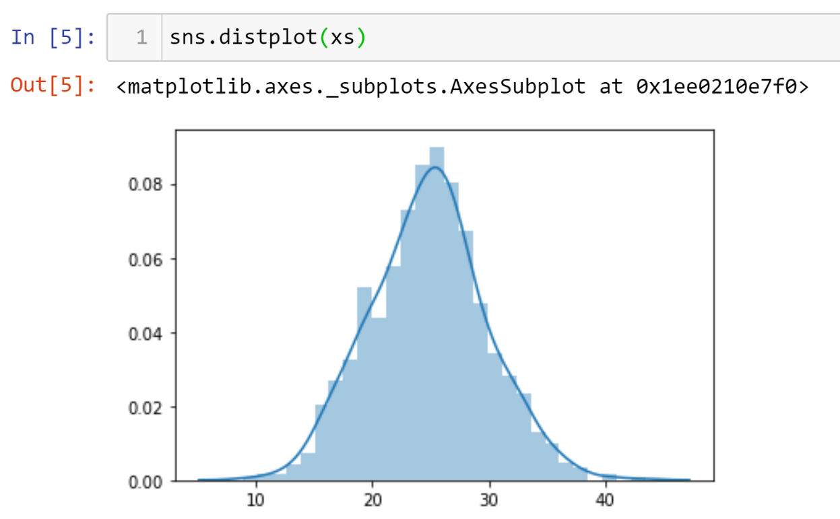
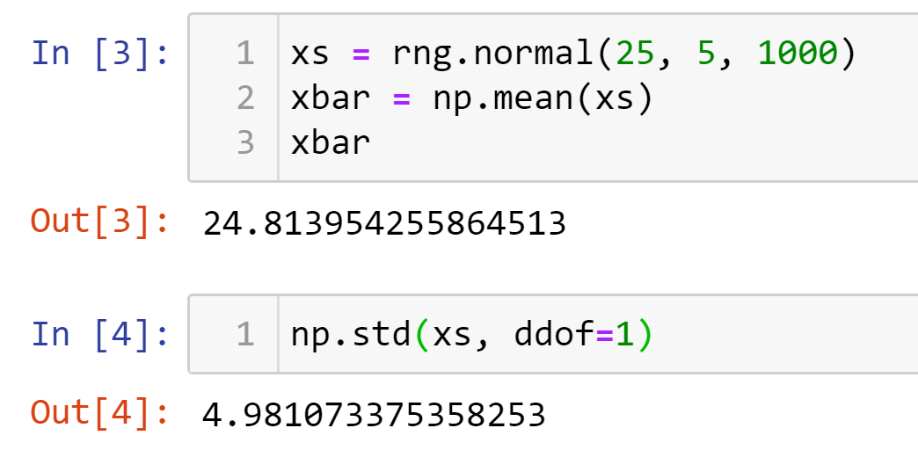
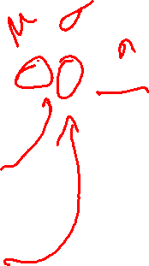
Example: Mean

Slide 9
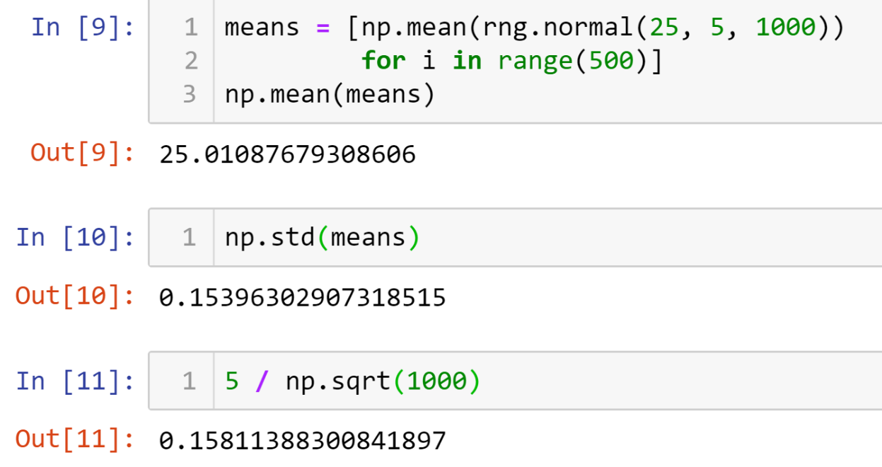
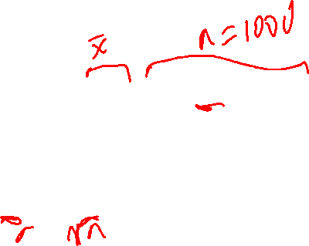
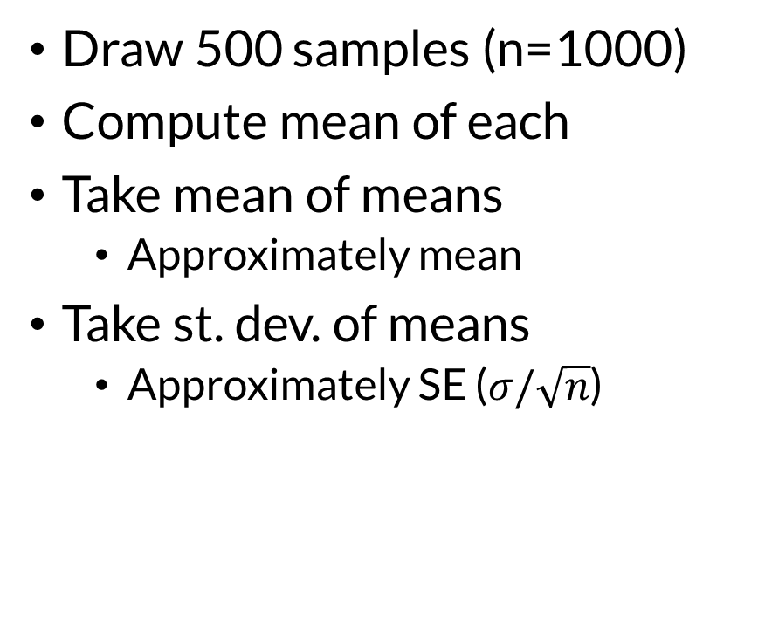
Simulating Means (Law of Large Numbers)
Draw 500 samples (n=1000)
Compute mean of each
Take mean of means
Approximately mean
Take st. dev. of means
Approximately SE ($σ/\sqrt{n}$)

Slide 10
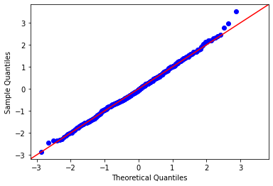
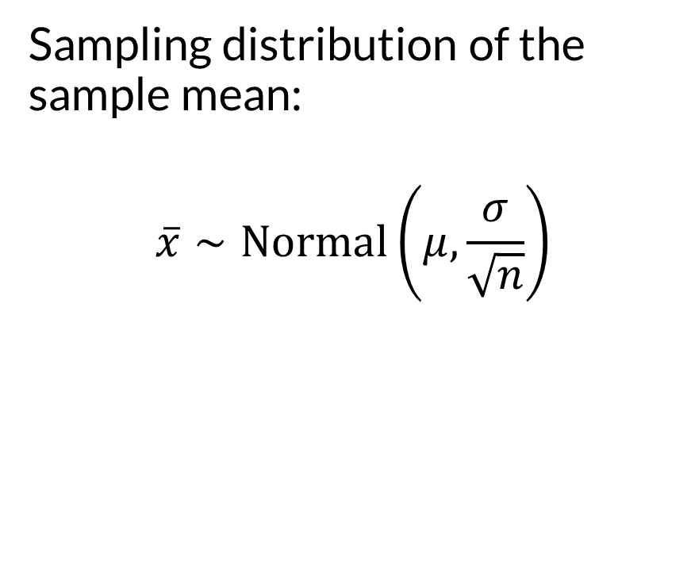

Simulating Means — Check for Normality
Sampling distribution of the sample mean:
$$\overline{x}∼Normal\left(μ,\frac{σ}{\sqrt{n}}\right)$$

Slide 11
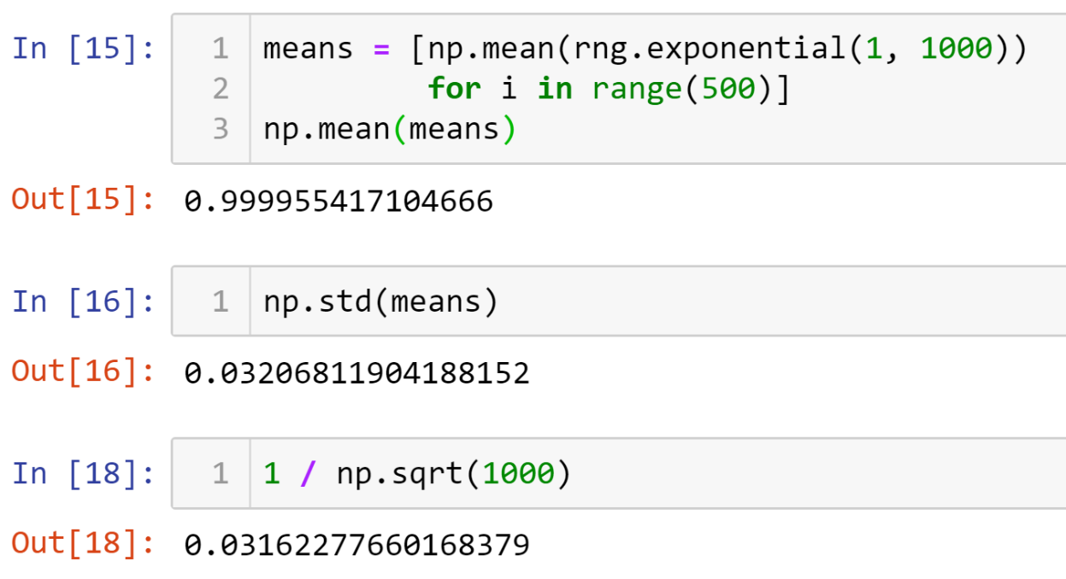
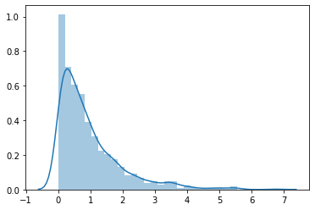


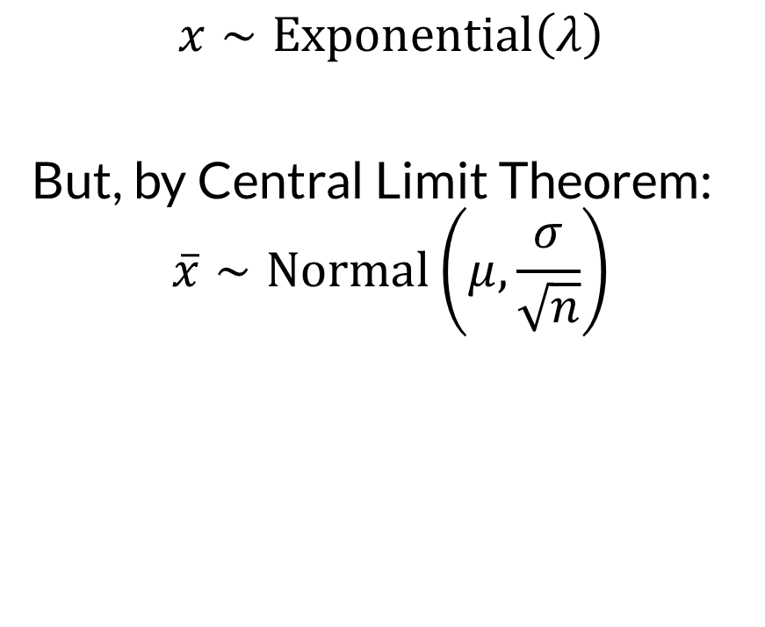
What about non-normal $X$?
$$x∼Exponential\left(λ\right)$$
But, by Central Limit Theorem: $$\overline{x}∼Normal\left(μ,\frac{σ}{\sqrt{n}}\right)$$
Exponential

Slide 12
Simulation
We have a proof of the Central Limit Theorem
More complex methods are much harder to characterize.
Simulation lets us explore behavior
Also: useful for learning, gaining intuition

Slide 13
Not the Bootstrap
Bootstrap
Simulation
Unknown population parameters
Resample actual observations
Estimate sampling distribution
Purpose: estimate population parameters
Known population parameters
Sampling from theoretical distributions, making up data
Characterize sampling distributions & other properties
Purpose: understand estimate / parameter relationships

Slide 14

Wrapping Up
Simulation lets us study the behavior of statistical methods by drawing many samples with known population parameters.
This is commonly used in statistics research. You do it in A4.
Photo by Aditya Chinchure on Unsplash

